Slide 1
Landing Zones for enterprise scale solutions

Slide 2
Creating accessible content
Take the following steps to create accessible content that everyone can consume effectively.
Contrast
Use high contrast colors for maximum readability
The recommended contrast ratio is at least 4.5:1
Color Contrast Analyzer
Download this tool to determine the legibility of text and the contrast of visual elements
Shape and color
Use different shapes with a legend to indicate statuses to accommodate for color blindness
Example:
Alt text
Alt text helps people with screen readers understand the content of slides
You can create alternative text for shapes, pictures, charts, tables, SmartArt graphics, or other objects
Here’s how:
Right click the image or shape
Select Format Picture… or Format Shape…
Select the Size & Properties icon
Expand the Alt Text field
Enter a Title and Description of your image or object
Slide layouts
Using a built-in slide layout that matches your content ensures a hierarchical reading order of text blocks
Example:
If a new slide will have a title, rather than starting with a blank layout and adding a text block for the title, choose one of the built-in layouts with a title placeholder
Reading order
Screen readers describe content on the screen in the order it was created
To ensure your content is read back in the order you prefer, arrange your objects in the Selection Pane appropriately. Objects on the bottom of the selection pane are read first
Here’s how:
Click the Home tab
In the Drawing group, select the Arrange drop-down menu
Click Selection Pane…
Text
Text
Text
Subject 1
Subject 2
Subject 3
Download
C1
C2
C3
Additional tips!
Be sure to run the Accessibility Checker! Go to File click the Check for Issues drop down menu click Check Accessibility
Videos need to be accessible: If your presentation includes a video, ensure it is captioned and audio described (if appropriate)
Visit the Office Accessibility Center to learn more about accessibility in PowerPoint

Slide 3
Abstract and learning objectives
Design landing zones for Azure at an enterprise-scale
Globally distributed enterprise scenario with management is centralized
Systems distributed and administered globally
Design and use enterprise-scale design principals for landing zones with Azure including
Utilize Azure resources & best practices
Challenges involved in managing Azure solutions at scale.

Slide 4
Step 1: Review the customer case study
Outcome
Analyze your customer needs
Timeframe
15 minutes

Slide 5
Customer situation
In-house and customer applications & data
Keep secure and available 100% of time
As business grows, scale your operations
Minimize costs and staffing needs
Teams and equipment in multiple countries
Different hardware in different regions
Hardware on different life-cycle, lease calendars throughout organization
Many alerts and trouble tickets around physical and network reliability outside of environments
Notes:
TODO: Turn the following into bullet points
As head of Infrastructure Operations for Contoso Logistics, you are responsible for keeping all your in-house and customer applications & data, secure and available 100% of the time, as well as ensuring all of your security comply with all relevant standards and regulations. As your business grows, you need to scale your operations activities accordingly—but you must minimize costs and staffing needs.
Currently, your teams and equipment distributed through out multiple countries with minimal consistency of hardware types and versions due to rapid growth and minimal staff to deal with local equipment. As your company continues to grow, hardware is purchased as needed and multiple different calendars are needed to maintain various life cycles of the hardware. In addition, a large amount of your team's time is focused on monitoring and responding to physical and network reliability that is often out of their direct management (ie: ISP or unreliable data centers) rather than supporting the performance of the application or end users.
Your challenge is to redesign your operations for consistent, reliable communications regardless of their locality and move away from revolving hardware costs while allowing for dynamic growth for variety of solutions and applications. You need to create efficient processes that enable your team to repeat the same process for any environment and allow for centralized management and reporting around a single platform.

Slide 6
Customer needs
Follow Best Practicies
Management Access
Backup and Disaster Recovery
Growth and Expansion
Patch Management
VM and Application Monitoring
Cost Management
Consistent Design
Notes:
1. **Follow Best Practices** The solution chosen for this deployment should follow well-known best practices and be repeatable for future needs. Also, utilizing pre-built solutions should be utilized to ensure deployment in the tight time frame. Furthermore, it should be easy to understand for future staff brought on through growth or augmentation.
2. **Management Access** Access to resources must be limited between different jurisdictions and managed through a central, agreed-upon authority. This must be monitored and have the ability to be reported on regularly for periodic audits. This should also be a consistent structure for all environments.
3. **Backup and Disaster recovery** All data and virtual machines need to be backed up on a daily basis. In addition, the critical systems must be to continue in the event of a disaster within 8 hours (RTO) with no more than a 2 hours of data loss (RPO).
4. **Growth and Expansion** The design of the infrastructure must allow for growth of capacity to process increase in demand of resources as well as expand storage for data as historical information is retained for long term storage.
5. **Patch Management** All systems must have the ability to be patched and kept up to date with centralized reporting to security services for reporting and monitoring.
6. **VM and Application Monitoring** The performance and availability of systems and applications must be monitored to ensure client experience is consistent. Also, trends and troubleshooting information should be available to support to help users and development group to improve features.
7. **Cost Management** As applications expand and grow, the costs to run those applications will often increase. The reporting of the applications should be able to tie back to the individual countries as well as applications.
8. **Consistent Design** The solutions proposed should provide a consistent and reliable design for all remote environments to minimize complexity and ease demands on the support team to ensure consistency of knowledge between areas.. The central environments should all mirror each other in design for disaster recovery purposes.

Slide 7
Customer objections
Reliability is a major concern
24/7 Global operations
99.95% SLA where possible
Optimized performance regardless of where the user is
Cost is an ongoing concern
Must be cost efficient
Easily break down costs to individual regions and applications
Security and compliance
Company spans multiple different juridictions with varying standards and compliance guidelines
Must ensure standard baseline across organization
Notes:
1. Reliability is a major concern as their business runs globally 24/7. Service goals should look to achieve 99.95% SLA where possible. In addition, the services should be optimized for performance regardless of where the user is in the world.
2. Cost is an ongoing concern for the enterprise. Solutions should not only be cost-efficient, but should be able to easily break down costs to individual regions for reports and parse application costs where possible.
3. Security and compliance are major concerns for the company. There are multiple different jurisdictional standards they must adhere to, but they must also ensure that their is standard baseline across all environments.

Slide 8
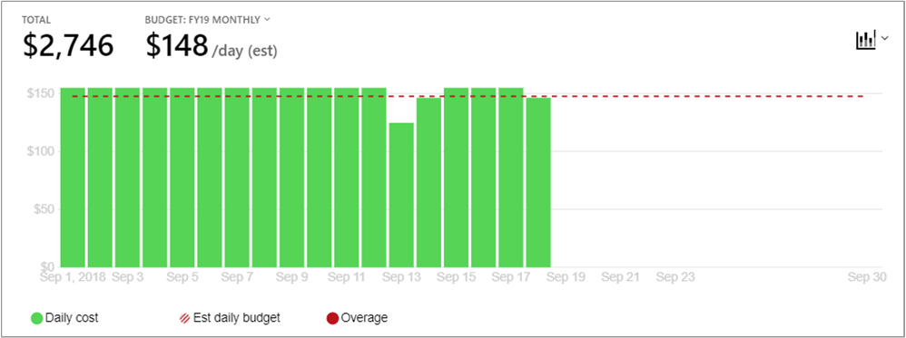
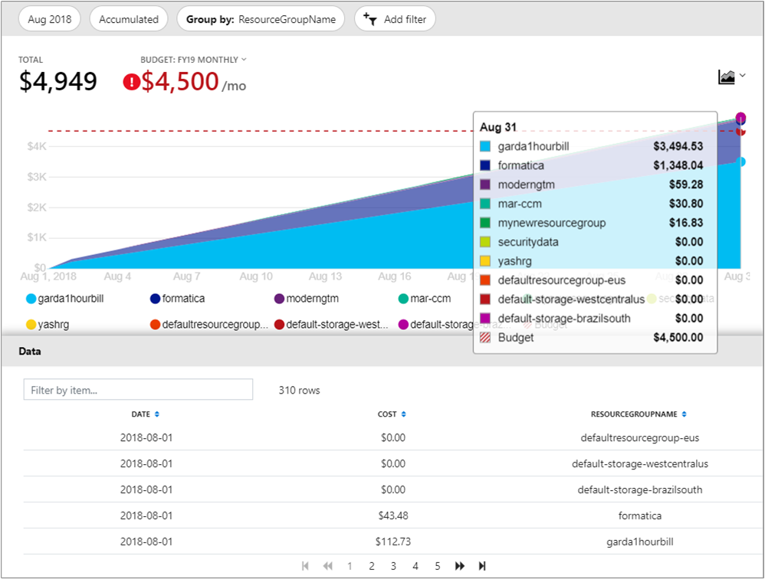
Common scenarios
Azure cost management
Understand where costs originate
Set budgets and alerts
Roll up reports across the organization with management groups
Delegated access to reports and usage

Slide 9
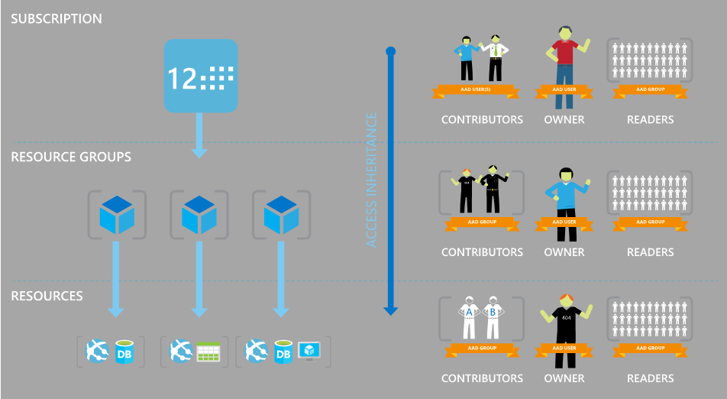

Common scenarios
Role-based access control (RBAC) and Azure policy
Governance of Azure resources
Granular access control

Slide 10
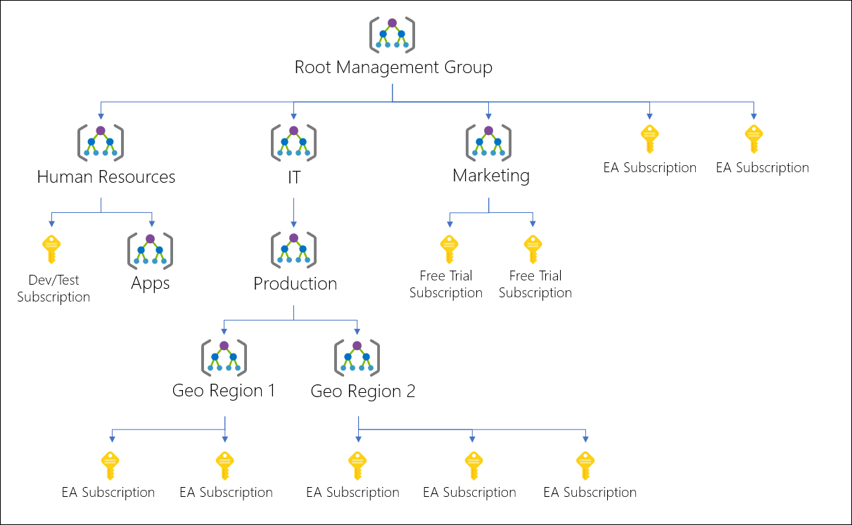
Common scenarios
Management groups
Apply governance at scale
Assign RBAC and policy across subscriptions
Aggregate Advisor, Security Center and Cost Management reports from across the organization

Slide 11
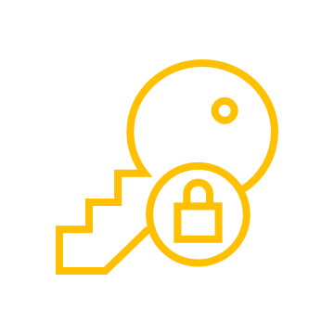
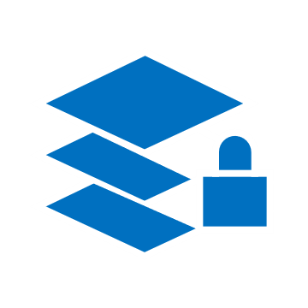
Common scenarios
Azure blueprints
Automated provisioning of entire environments
Deployment tracking and updates
Optional locking against unauthorized changes
Role-based access controls
Policy Definitions
Subscription A
Templates
Azure Blueprints
Subscription B
Subscription C
…

Slide 12
Step 2: Design the solution
Outcome
Design a solution and prepare to present the solution to the target customer audience in a 15-minute chalk-talk format.
Timeframe
60 minutes
Business needs (10 minutes) | Respond to questions outlined in your guide and list the answers on a flipchart
Design (35 minutes) | Design a solution for as many of the stated requirements as time allows. Show the solution on a flipchart
Prepare (15 minutes) | Identify any customer needs that are not addressed with the proposed solution Identify the benefits of your solution Determine how you will respond to the customer’s objections Prepare for a 15-minute presentation to the customer

Slide 13
Step 3: Present the solution
Outcome
Present a solution to the target customer in a 15-minute chalk-talk format
Timeframe
30 minutes (15 minutes for each team to present and receive feedback)
Directions
Pair with another table
One table is the Microsoft team and the other table is the customer
The Microsoft team presents their proposed solution to the customer
The customer asks one of the objections from the list of objections in the case study
The Microsoft team responds to the objection
The customer team gives feedback to the Microsoft team

Slide 14
Wrap-up
Outcome
Identify the preferred solution for the case study
Identify solutions designed by other teams
Timeframe
15 minutes

Slide 15
Preferred target audience
Leader | Hugo Fisher, CEO
Finances | CFO
Security | CSO
Application(s) Owner | Lead of Application Design
Regional Heads

Slide 16
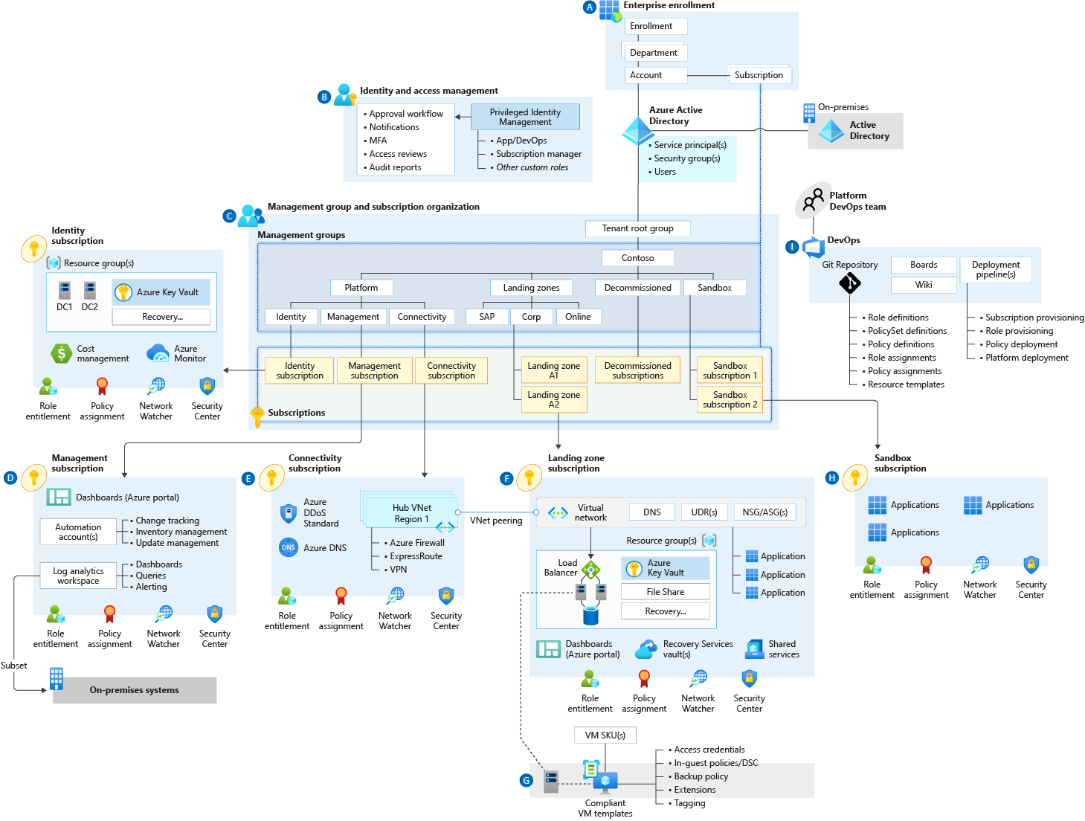
Preferred Solution

Slide 17
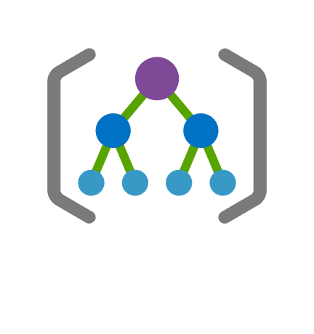
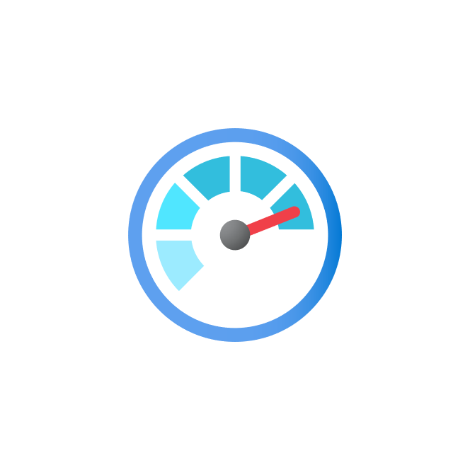

Preferred solution
Consistent Design
Blueprints based on Hub/Spoke design
Management Access
Management groups to organize subscriptions by regional needs
RBAC with accounts from Azure AD sync’d with existing AD DS
Backup and disaster recovery
Azure Site Recovery for Disaster Recovery
Backup via Recovery Services Vault with Policies
Growth and expansion
Scale Sets where possible
Azure Monitor for load and monitoring for Scale Up
Azure NetApp for storage needs
Notes:
7. **Consistent Design** The solutions proposed should provide a consistent and reliable design for all remote environments.
- There should be a standard, central designed that is repeated in each environment
- The application is consistent around each environment, so the structure must be the same in each environment
- Updates to the infrastructure should be possible without interruption and minimal affect to the existing environment
- Rapid deployments for critical or security updates should be available from a central system across all environments
*Solution*
***NOTE**: While this is an obviously important need of the client, solving this piece gives the client many of the other needs as well, so moving this to the top of the list*
By utilizing [enterprise-scale landing zones](https://docs.microsoft.com/en-us/azure/cloud-adoption-framework/ready/enterprise-scale/) as part of the Cloud Adoption Framework (CAF), the client can utilize a standard blueprint in all regions and deployments to ensure a standard experience regardless of the location or subscription.
Start with an example from the GitHub repository that ties back to a centralized network for a [Hub-Spoke](https://github.com/Azure/Enterprise-Scale/blob/main/docs/reference/adventureworks/README.md) or [VWan](https://github.com/Azure/Enterprise-Scale/blob/main/docs/reference/contoso/Readme.md) structure will allow communication of only those resources intended (such domain replication, no localized data, etc) and build on additional resources and data needed for the company's application.
The following sections will go over most of the design areas that should be focused on within the blueprint's design.
1. **Management Access** Design a solution to allow CL operation team with access to the divisional subscriptions.
- The solution should support role-based access control to ensure consistent and reportable access across the environments
- The solution should support user groups so as staff changes, access remains consistent and does not require redeployment
- The solutions should also follow an inheritance structure where possible to allow for top-down distribution of rights
*Solution*
Existing users and groups can be synchronized with Azure AD via Azure AD Connect. This can allow the same accounts and security in both locations to minimize management and ease use of users.
Azure Resource Based Access Control (RBAC) provides the ability for limiting access to the environment. Groups should be created in Azure AD around the roles of the users. These groups should then be utilized to grant access by assigning **Roles** to Azure AD **Groups** using **Role assignments** to the Azure Subscription(s), Resource Groups, and Resources. Access should only assigned to the groups and assignments should not be applied via individual users. Users should then be added as members to the respective groups.
Moreover, Management Groups can be utilized at the regional or national level to control access on member subscriptions based on reporting or compliance needs. This ensures that multiple subscriptions within an area of reporting follow the same restrictions and guidelines
For developers and third parties that temporarily need access, Azure AD B2B collaboration (also known as guest users) should be utilized to grant them access to the resources on a temporary basis. These guest users should be applied to groups as above and permissions granted to those groups. The manager should be specified as the person within the company responsible for the guest user for audit and tracking purposes. When the third party no longer needs access, the **Block sign in** should be set to **Yes** and the account removed if no longer expected in the future.
2. **Backup and Disaster recovery** All data and virtual machines need to be backed up regularly and critical systems continue in a disaster.
- The solution must provide for the ability to backup and retain their data daily and have standard configurations for maintaining company standards
- The solution must also ensure that critical systems continue to function in the event that there is a major disaster in a geographical area
- The solution must also ensure their critical systems are down for no more than 8 hours and loose no more than 2 hours worth of running data
- The solution should also be able to be monitored and report if there are any issues or inconsistencies.
- The solution should allow for reporting of systems that are not configured for protection
*Solution*
The virtual machines should utilize Azure Recovery Vault for Backup for their region. Azure Policies in the blueprint can also be configured to ensure all production virtual machines are applied to a backup policy. Each region can then specify the Backup policy for their regulatory needs and their systems will follow those standards.
In addition, Azure Site Recovery within an Azure Recovery Vault should be setup for disaster recovery of critical systems. The following systems need to be setup in the blueprint for production environments:
- A second region to recovery resources in that is geographically separate from primary location
- Virtual Network (VNet) with similar setup to production environment (including subnets, NSG, ASG, etc)
- Recovery Plan setup to orchestrate failover (such as AD DS services, SQL Servers, then Web Servers)
- Settings outside of the virtual machines such as public IP addresses, remote network connectivity, etc. in one of the following ways:
- Via Recovery Plan either via Manual Steps (accounting for human & deployment time in RTO and instructions needed) or Automated Steps (accounting for development time, execution time (RTO), costs & complexity)
- Via Pre-staged resources (costs considerations & automated steps needed should be considered such as Traffic Manager or Private routing via VPN tunnels to a Virtual Network Gateway)
The following aspects can then be setup and performed within each region:
- ASR deployed to systems identified as 'critical'
Regular tests of each system should be done regularly:
- Backups - every 2 - 6 months attempt to restore sets of critical files from backup to alternate server and verify consistency
- ASR - Every 3 - 6 months perform Test Failover and run Quality Assurance (QA) tests against applications to ensure they work in DR scenario
3. **Growth and Expansion** The design of the infrastructure must allow for growth of capacity of both compute and storage.
- Virtual machines and applications should be able to grow or expand dynamically based on load
- Storage of data should be available to retain legacy data for longer periods at a reduced rate
- Storage of sensitive, or regulated data, should be kept within the local regions to ensure proper jurisdictional oversight
- Structure of the data containers should be consistent across environments to allow for easier retrieval
*Solution*
As the initial goal is to get virtual machines from teh hardware on premise into the cloud, the main focus here should be ensuring the Virtual Machines are sized appropriately utilizing the Azure Migration resources to account for current loads. It should then be advised to the client to Scale Up (increase size) the Virtual Machines to another size VM in off hours (as this requires a reboot of the VM) if the load is observed to be to high (either by user reports & troubleshooting or observed via logging [later])
Virtual Machine Scale Sets could potentially be a solution for the applications of the client (Scale Out); however, it is not known that the application would work or function in such a scenario. Many applications keep stateful information on their local systems and thus could cause problems if the design relies on this solution. Due to time frame and unknowns, this is not a recommended solution but instead would be a follow step to prove validity in Azure then deploy to production.
Storage for the database servers should mirror existing size of data use plus space for growth in two different ways:
- Locally attached disks - growth should then be possible via attaching additional disks. This can either be done by:
- attaching additional and/or larger disks, but databases must be moved to the new disks
- setup storage pools on local machine, add additional disks, and expanding volumes
- SAN storage (additional costs and sometimes minimum levels)
- Azure NetApp can provide storage via SMBv3
- Windows Storage Space VM or third party SAN VM (DR must be maintained for these VMs or their storage)
Migration of applications to Azure PaaS solutions should be achieved by the following:
- Setting up a Development subscription
- Allow developers access to this subscription with limited types of resources via policy and monitored costs
- Utilize AAD for application management and SQL PaaS
- Copy data from production subscription to development subscription excluding PII and sensitive data
- Develop and test solution
- Once application confirmed and validated, deploy application to production subscription in new Resource Groups
- Migrate data to Azure SQL PaaS via Data Migration tool
- Redirect traffic utilizing Traffic Manager
- Switch traffic to PaaS
- Backup VMs
<CLICK FOR MORE>

Slide 18

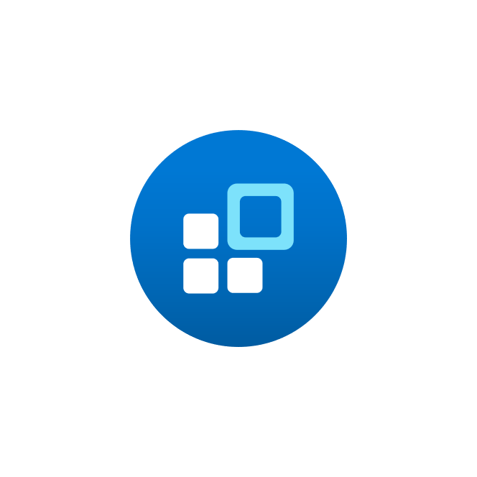


Preferred solution (con’t)
Patch Management
Azure Automation for VMs
Redundant systems where application supports
PaaS handled by Azure
VM and Application Monitor
Log Analytics feeding into Azure Monitor
Alert levels defined locally
RBAC to grant access to those that need information
Cost Management
Cost Center configuration and alerts
Dashboards and PowerBI for visualizing and reporting
Tagging enforced via Policy to ensure metadata for reports
Azure Migrate to determine right size of VMs
Notes:
4. **Patch Management** All systems must have the ability to be patched and kept up to date
- Patch management must be maintained across all systems
- Reports should be available centrally to allow for monitoring and compliance
- Local administrators should be alerted to any systems not included in management
*Solution*
[Azure Automation](https://docs.microsoft.com/en-us/azure/automation/update-management/manage-updates-for-vm) allows for the approval and deployment of patches to Azure VMs. By utilizing this tool, machines can be centrally managed and monitored via Azure as well assessing their compliance.
Alternatively, a WSUS server could be deployed for a more typical management, but this requires a different management interface as well as an additional server. There are nuanced locations this could be required, but it is likely not needed for this client.
Azure PaaS resources for future deployments are kept patched and up to date by the Azure team and no tasks are needed by the client.
5. **VM and Application Monitoring** The performance and availability of systems and applications must be monitored to ensure client experience is consistent.
- Local administrators should be alerted to any critical events and be able to respond appropriately
- Reports of trends and status should be available to support to help users
- Development group should be able to have access detailed logs only in the event of an escalation
*Solution*
Azure Monitor should be utilized to report on the status of virtual machines and PaaS resources in the future. The
The design of the Alerts and Alert groups will need to be setup as part of the
6. **Cost Management** Reporting of costs should be made available to track and monitor expenses within the environment.
- Reports must be available within each region and available to centralized management
- Filtering of costs should be available by categorization of applications or other metadata
- Certain data must be included on all resources relating to its purpose to allow for categorization
*Solution*
The landing zone blueprint should include the tools need to [track costs](https://docs.microsoft.com/en-us/azure/cloud-adoption-framework/ready/azure-best-practices/track-costs) and provided visibility to finance teams, management teams, and/or apps teams.
Furthermore, tagging policies for metadata can be setup and enforced via the landing zone blue print to ensure that application information is tagged on resources to allow for more detailed reporting via the costs center.

Slide 19
Preferred objections handling
Reliability
Availability Zones provide 99.99% where available, Availability Sets provide 99.95%
Front Door provides global CDN delivery as well as Perimeter security
Cost
Cost management to monitor and track usage
Policies to ensure metadata tagging for reports and classification
Security
Azure AD can provide MFA and monitoring of logins globally
Azure AD B2B to allow for guest access with consistent requirements for authentication
RBAC can provide reliable, consistent security configurations in each blueprint
Access can be governed within each region
Notes:
TODO:
Make list of key
1. Reliability is a concern as their business support people throughout the world. Service goals should look to achieve 99.95% SLA where possible. In addition, the final application services should be optimized for performance regardless of where the user is in the world.
*Response*
The ability to run critical VMs, such as SQL or Application, with Availability Sets will allow the VMs to achieve 99.95% via Azure's SLA. In addition, for added reliability, Azure Zones can allow for SLA's up to 99.99%, but they require some additional setup and not available in all regions. If this is selected, ensure a region that supports Availability Zones were used.
For improved performance regardless of where the user is in the world, Front Door would provide a secure permitter solution with a Content Deliver Network (CDN) to allow for access geographically closer to the end user.
2. Cost is an ongoing concern for the enterprise. Solutions should not only be cost-efficient, but should be able to easily break down costs to individual regions for reports and parse application costs where possible. In addition, the final solution should be able to scale up and down depending on the current demand.
*Response*
Cost reporting is always an important concern in almost all Azure clients' subscriptions. Having cost center configured and alerting will provide the best reporting and active monitoring of costs. Adding metadata with Tags to resources by standard and/or policy can help identify where costs are going.
Using Azure Migration services to help properly identify resource needs ahead of time and allow for right sizing can provide the best option to ensure systems are not oversized. On going monitoring via Azure Monitor can also help identify systems that are over provisioned.
In addition, developing a clear road map to get the application away from costly, generic compute costs like VM into optimized solutions with PaaS pieces can help take advantage of dynamic sizing and growth to get the best performance out of their dollars.
3. Security is a major concerns for the company. Users' personal identity information (PII) must be kept confidential and secure from both people outside the organization, as well as personnel within the company that do not need access for their work.
*Response*
By utilizing RBAC for Azure resources, we can ensure that only those users with defined roles have only the intended access they need to the Azure environment. Furthermore, by utilizing Azure AD, we can allow users to utilize their existing identities and better harden access with those accounts.
In addition, we can bring in identities from partners on an as needed basis via Azure AD B2B with secure communications and defined access while minimizing exposure of our systems and management tasks.
Finally, as the client moves to resources such as Azure SQL to extend RBAC structure and utilize features such as [Dynamic Data Masking](https://docs.microsoft.com/en-us/sql/relational-databases/security/dynamic-data-masking)

Slide 20
Customer quote
“From the details and designed help of Azure Landing
Zones, we were able to quickly build our own blueprints
to ensure reliable and consistent design across our entire
enterprise. In addition, we've are able to utilize the
central reporting and management tools for tracking
and watching our systems for now into the future as we
continue to grow and scale our solutions.”
- Hugo Fisher, Founder of Contoso Logistics

Slide 22
STOP
Only template slides after this

Slide 23
Text layout (without bullet points)
Main topic 1: size 36pt
Size 28pt for second level
Size 24pt for third level
Size 22pt for fourth level
Size 22 for fifth level

Slide 24
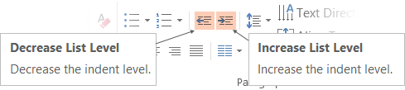
Text with bullet points - adjusting list levels
Main topic 1: size 36pt
Size 28pt for second level
Size 24pt for third level
Size 22pt for fourth level
Size 22 for fifth level
Use the “Decrease List Level” and “Increase List Level” tools on the Home Menu to change text levels.
Try this:
Place your cursor in any row of text to the left that says “Size 20pt for subtopics”
Next click the Home tab, and then on the “Decrease List level” tool. Notice how the line moves up one level.
Now try placing your cursor in one of the “Main topic…” lines of text. Click the “Increase List Level” tool and see how the text is pushed in one level
Use these 2 tools to adjust your text levels as you work

Slide 25
Bullet points layout with subtitle Subtitle is smaller in the same text block
Example of a bulleted slide with a subhead
Set the slide title to “Sentence case”
Set subheads to “Sentence case”
Hyperlink style
www.microsoft.com

Slide 26
Photo layout 1

Slide 27
Demo

Slide 28
Video

Slide 29
Section title

Slide 30
Software code slide
This slide layout uses Consolas, a monotype font which is ideal for showing software code.

Slide 31
Notes (hidden)
Some speakers at Microsoft like to use this slide for hidden “notes slides”.
Delete it if you don’t want to use it.
NEXT: <next slide title>

